Slide 1
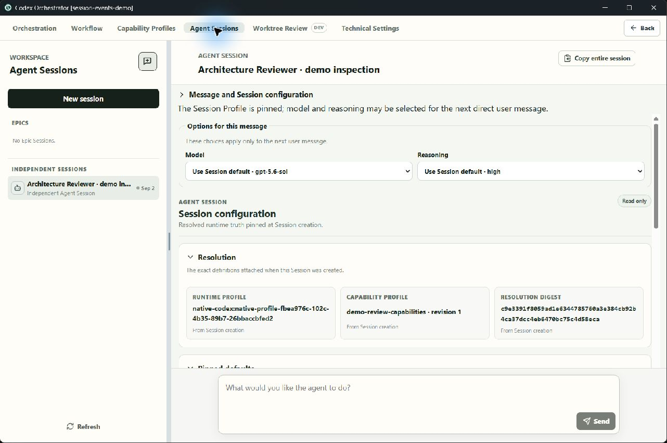
CODEX ORCHESTRATOR · UI WALKTHROUGH
SEEDED INSPECTION FIXTURE
From Harness UX
to Session Events
A screenshot-led walkthrough of capability exposure, node configuration, event compilation, and pinned runtime truth.
BRANCH aaca806
NO PROVIDER DISPATCH
Captured 2 Sep 2026
Notes:
Frame the walkthrough as a model and UI boundary review, not a claim of production completion. The Capability Profile and Workflow authoring states are live in the isolated desktop demo. The Agent Session is a seeded inspection fixture so the presentation can show pinned truth and provenance without triggering a provider.
[Sources]
- Local capture: 08-session-profile-and-message-controls.jpg
[/Sources]

Slide 2
CONCEPTUAL MAP
02
The UI now exposes five distinct layers
1
2
3
4
5
Selected runtime
→
Capability Profile
→
Node Profile
→
Session Event
→
Session Profile
Provider-managed exposure
Reusable technical boundary
Embedded operational config
Trigger + prompt + target
Pinned runtime truth
The boundaries are intentionally legible before they are made extensible: authoring owns definitions; Session Events own execution semantics; Agent Sessions expose resolved truth.
Notes:
Walk left to right. The selected runtime is observed, not configured here. A Capability Profile narrows what is available. Each Workflow node embeds its own Node Profile. Nodes and connections compile into Session Event definitions. Creation resolves and pins a Session Profile. The key architectural property is that each layer has a clear consumption contract.
[Sources]
- Derived from the captured live authoring and seeded inspection surfaces in this deck.
[/Sources]

Slide 3
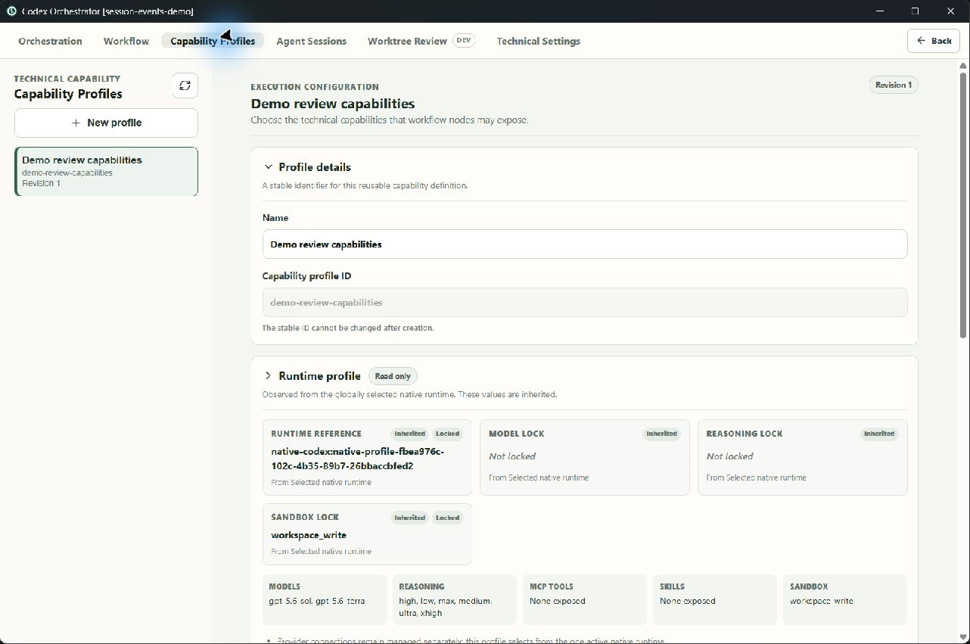
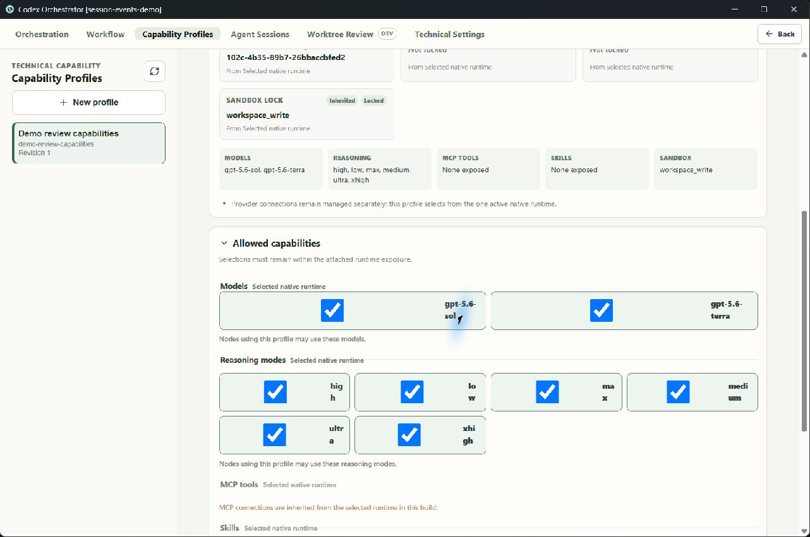
AUTHORING SURFACE
03
Capability Profile: reusable technical exposure
The globally selected native runtime is visible as read-only inherited truth.
LIVE AUTHORING STATE
LIVE AUTHORING STATE
Models, reasoning modes, and sandbox modes can be narrowed for downstream nodes.
MCP tools and skills are shown as inherited and disabled in this bounded slice.
Boundary rule
A Capability Profile may only narrow the attached runtime. Provider connection setup remains a separate concern.
Notes:
Start with the profile details, then point to the runtime summary. The UI is explicit that this object consumes one selected native runtime rather than configuring providers. Move to the second capture to show the editable narrowing surface and the inherited MCP/skill treatment.
[Sources]
- Local capture: 01-capability-profile-overview.jpg
- Local capture: 02-capability-allowed-selections.jpg
[/Sources]

Slide 4
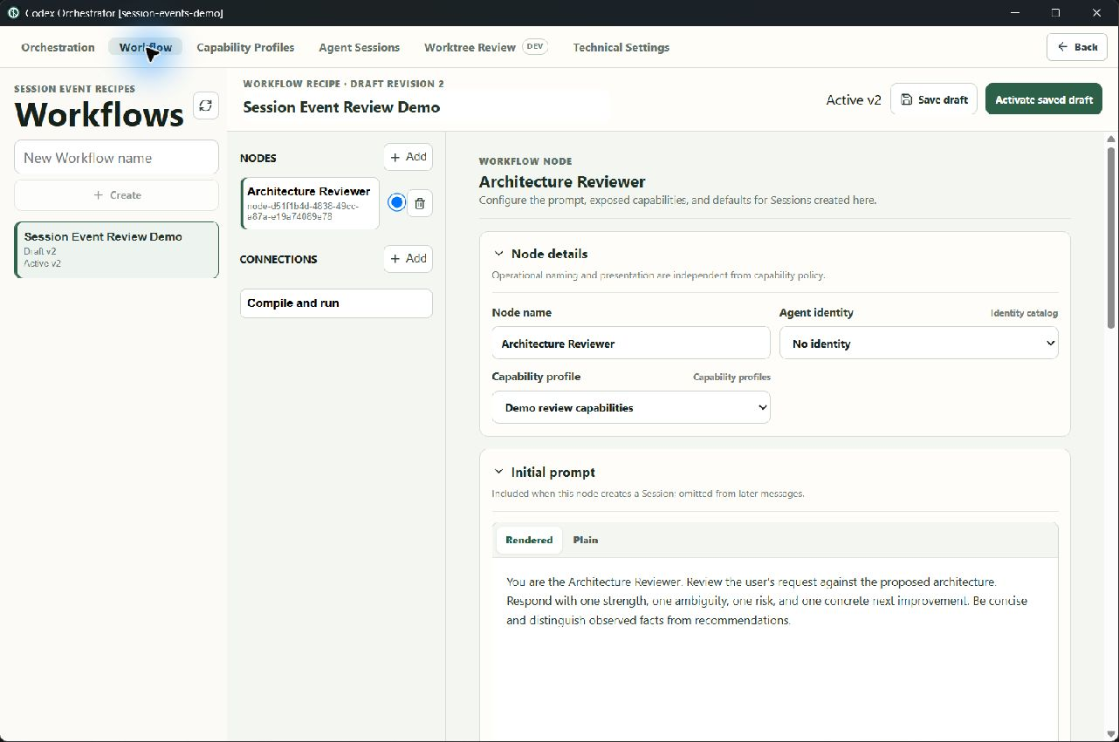
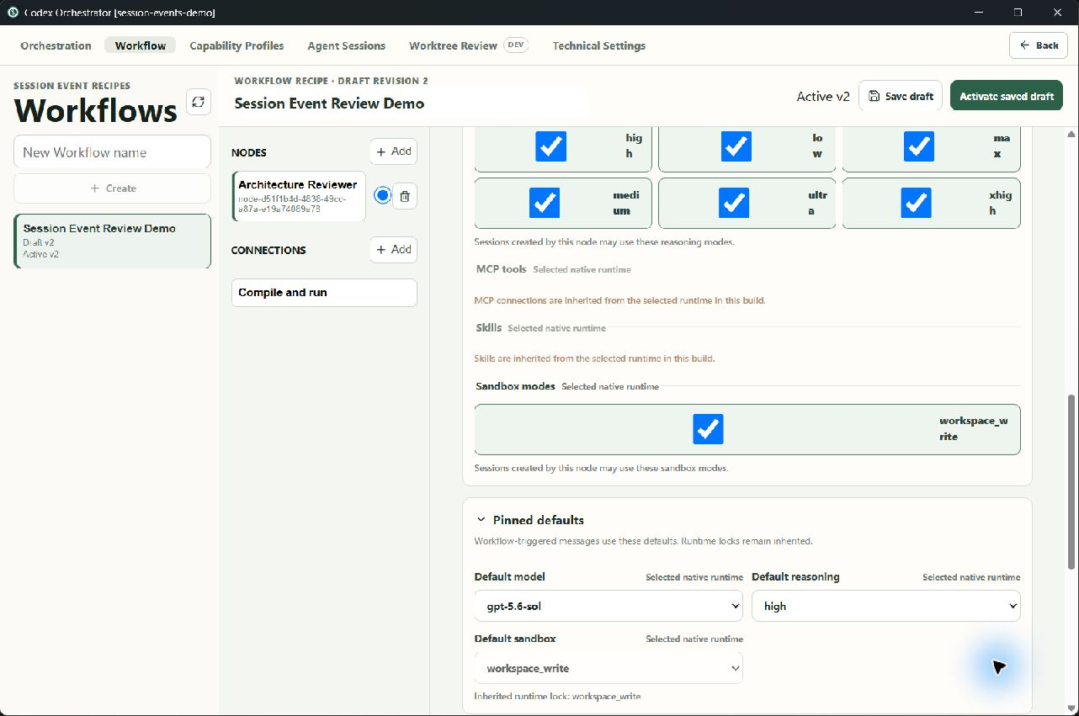
WORKFLOW NODE
04
Node Profile: embedded, copyable operational context
The initial prompt is included only when this node creates a Session.
LIVE AUTHORING STATE
LIVE AUTHORING STATE
Node capabilities can narrow the selected Capability Profile again.
Pinned defaults govern workflow-addressed messages; identity remains separate.
Current reuse decision
There is no shared Node Profile catalog. Copying creates independent node state that can be edited locally.
Notes:
Use the first capture to separate operational naming, Agent identity, Capability Profile selection, and the creation-only prompt. Use the second to show that restrictions and defaults are visible in the same node editor. Emphasize that Node Profile reuse is deliberately deferred; the supported operation is copy then edit.
[Sources]
- Local capture: 03-workflow-node-profile.jpg
- Local capture: 04-node-restrictions-and-defaults.jpg
[/Sources]

Slide 5
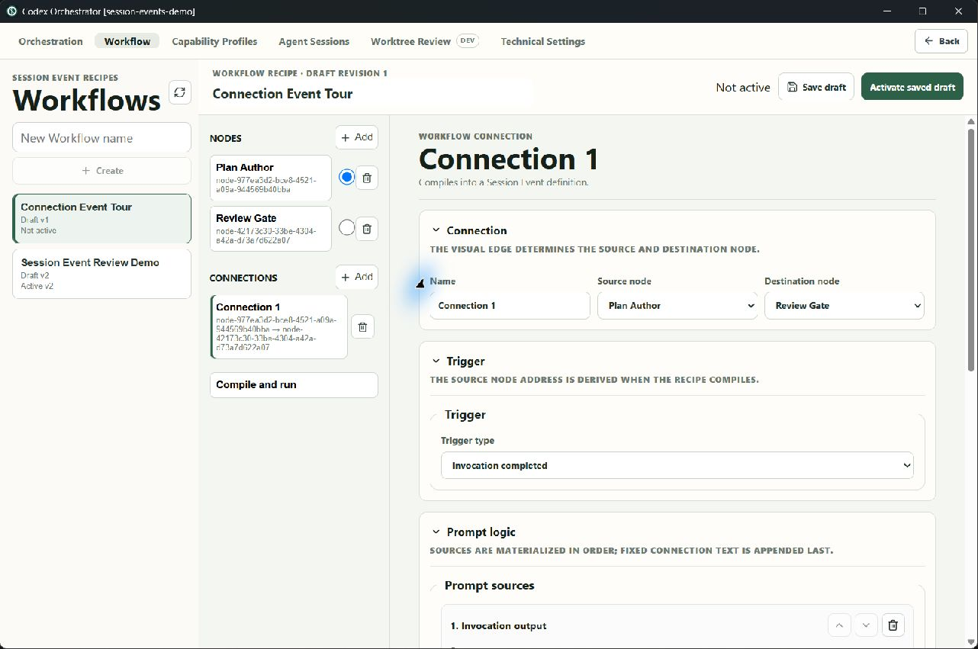
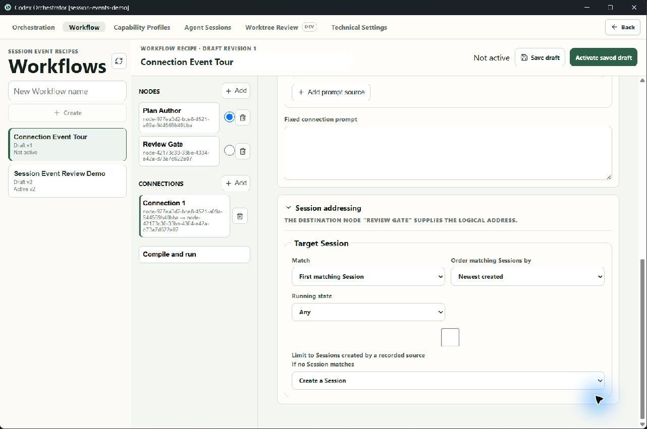
WORKFLOW CONNECTION
05
A visual edge compiles into a Session Event definition
Trigger: invocation completed for the source node address.
LIVE AUTHORING STATE
LIVE AUTHORING STATE
Prompt: ordered sources plus optional fixed connection text.
Target: destination node address, selection order, running filter, and no-match policy.
Abstraction boundary
The Workflow editor arranges recipe concepts. The compiled result is expressed entirely in the generic Session Event model.
Notes:
Describe the connection as an authoring convenience rather than execution truth. The source and destination nodes derive logical addresses. The trigger, ordered prompt sources, target cardinality/order/filter, and create-on-missing behavior are already explicit in the editor. This is the functional layer a future script or custom provider would target.
[Sources]
- Local capture: 05-connection-trigger-and-prompt.jpg
- Local capture: 06-connection-prompt-and-target.jpg
[/Sources]

Slide 6
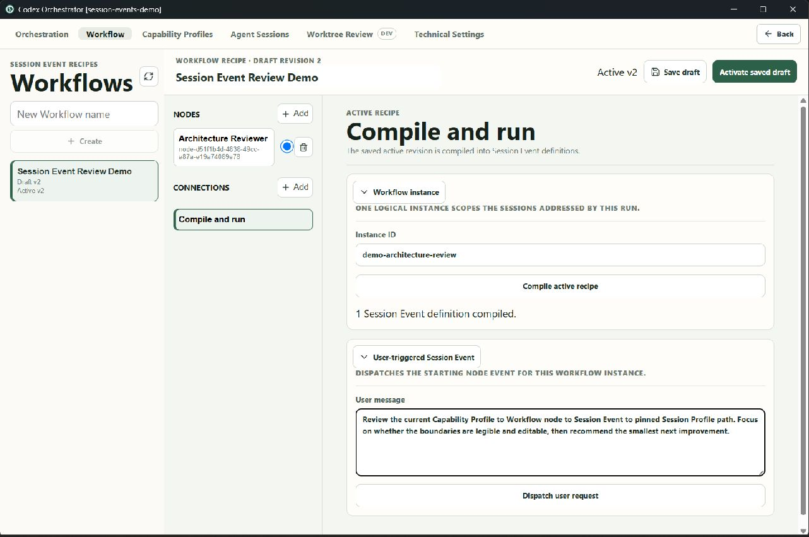
COMPILE AND RUN
06
Compilation is explicit; dispatch is separate
LIVE · NOT DISPATCHED
A Workflow instance ID scopes all logical Session addresses for the run.
The active recipe compiles into one or more Session Event definitions.
The user-triggered occurrence is staged independently from dispatch.
0 PROVIDER INVOCATIONS
0 RUNTIME SESSIONS
Notes:
This is the safety and legibility checkpoint. Compilation produced a Session Event definition for the named Workflow instance, but the request was never dispatched. The UI makes the boundary visible: authoring and compilation can be reviewed before any provider work begins.
[Sources]
- Local capture: 07-compile-and-run.jpg
[/Sources]

Slide 7
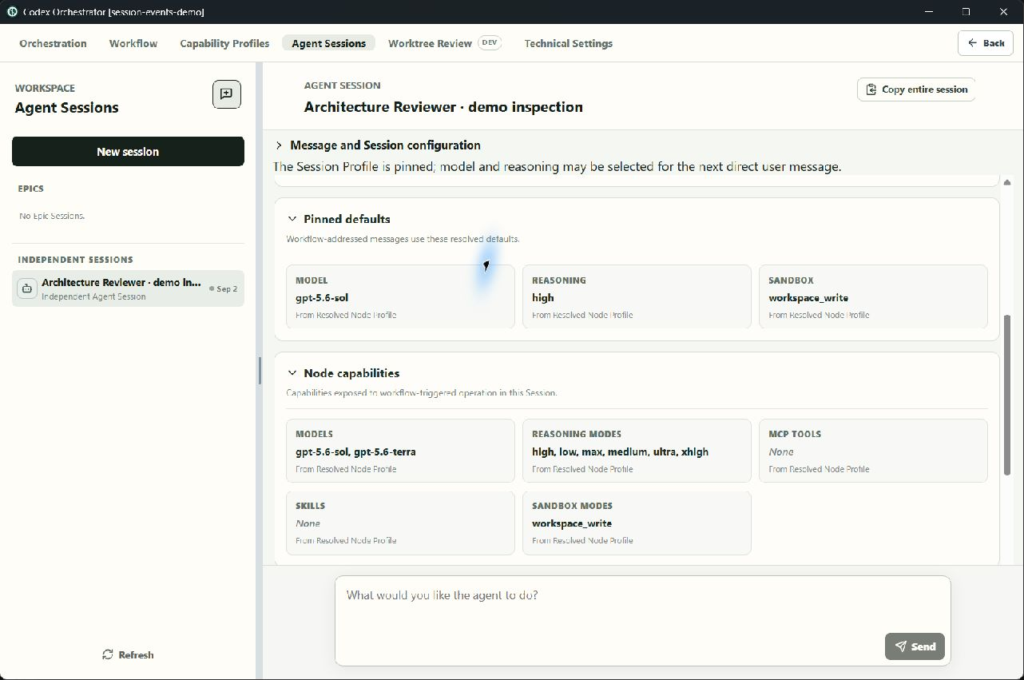
AGENT SESSION
07
Sessions pin truth; user prompts keep local choice
The Session stores the resolved runtime reference, profile revision, and digest.
SEEDED FIXTURE
SEEDED FIXTURE
Workflow messages use pinned model, reasoning, and sandbox defaults.
A direct user message may choose any attached runtime model and reasoning mode for that message only.
Important distinction
The message selectors are not a mutable Session override profile. They resolve invocation-local user authority against the attached runtime.
Notes:
This slide uses a seeded inspection record. Point first to the model and reasoning selectors: they apply only to the next direct user message. Then point to the immutable resolution metadata. Workflow-addressed messages continue to obey the pinned Node Profile defaults, while direct user prompts can use the wider attached runtime exposure.
[Sources]
- Local seeded capture: 08-session-profile-and-message-controls.jpg
- Local seeded capture: 09-pinned-defaults-and-node-capabilities.jpg
[/Sources]

Slide 8
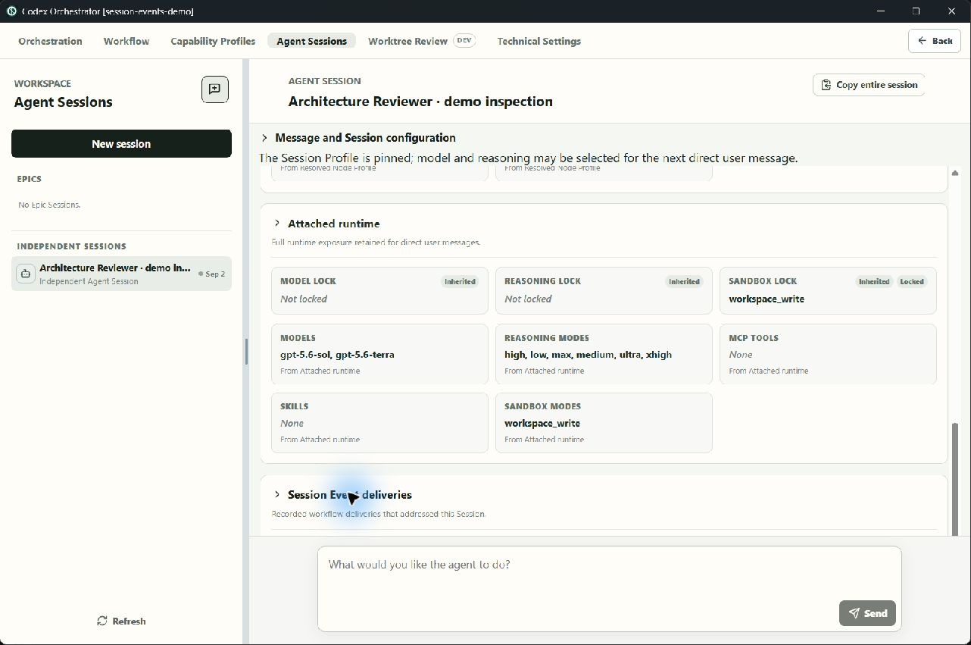
WALKTHROUGH CLOSE
08
Runtime truth and provenance are inspectable from the Session
SEEDED FIXTURE
Questions for review
Are the five boundaries legible enough to edit confidently?
Does the Session view expose enough provenance for day-to-day work?
Which run-level projection should be designed next—without assuming it is a graph?
Deferred: canonical run UI, robust custom providers, role concepts, and provider connection management.
Next conversation: refine the presentation surface around proven functional boundaries.
Notes:
Close by showing that attached runtime exposure and recorded delivery provenance are separate from pinned node truth. The Session Event delivery section exists, but the canonical run projection is intentionally deferred. Use the three questions to guide the review and resist choosing a graph or role abstraction prematurely.
[Sources]
- Local seeded capture: 10-attached-runtime-and-delivery-provenance.jpg
[/Sources]

